Slide 1

SE PRoject
Steven Danko
Josh Wiles
Garrett Hillyer

Slide 2
Major Responsibilities
Create a system for automating conference events
Include
Automated Conference Creation
Guest Management
Cost Tracking and Expense Management
Equipment Maintenance and Support
Event Planning and Coordination
User-Friendly Interface for Staff

Slide 3
System Features
Guest Management
Allows guests to check in for an event at UCC and view the event schedule
Check in
View schedule of conferences
Event Planner Functions
Provides event planners with various functionalities
View schedule
Schedule and enter events
Cancel events
View cost of hosting an event

Slide 4
System Features
Employee Functions
Employees have various functionalities
View Schedule
Schedule and enter events
Cancel event
View the cost of hosting an event

Slide 5
System Features
Maintenance Functions
This feature enables event planners to request maintenance and assistance
Order new presentation equipment
Request assistance with presentation equipment
Schedule conference room maintenance
Report conference room maintenance issues
Report damaged or broken presentation equipment
File maintenance complaints

Slide 6
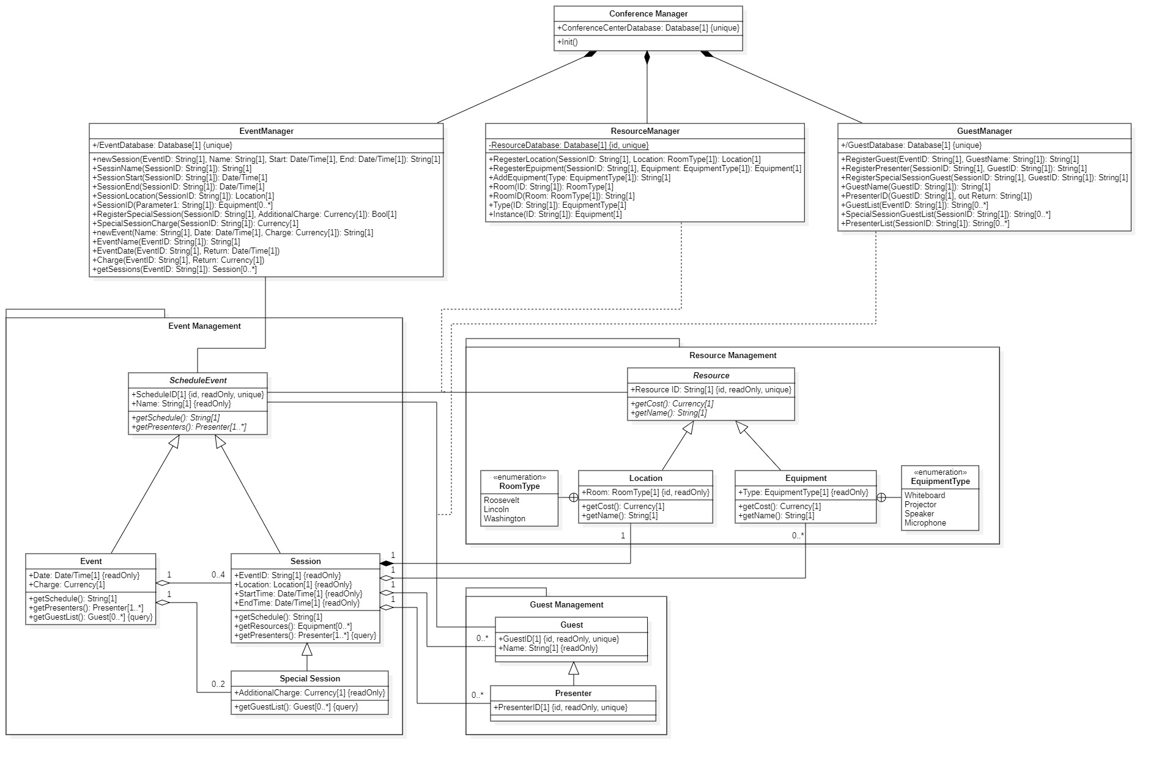

Slide 7
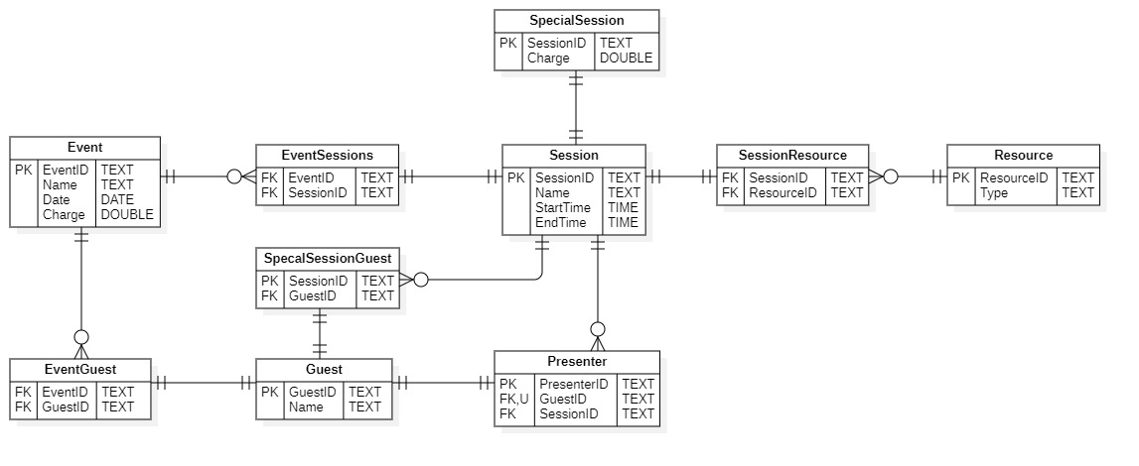

Slide 8


Frontend
The front end of the project was created using a WPF desktop application. WPF is exclusive to Windows and uses C# and XAML markup. WPF is flexible and highly customizable (on Windows) and C# tends to play nice with C++.

Slide 9
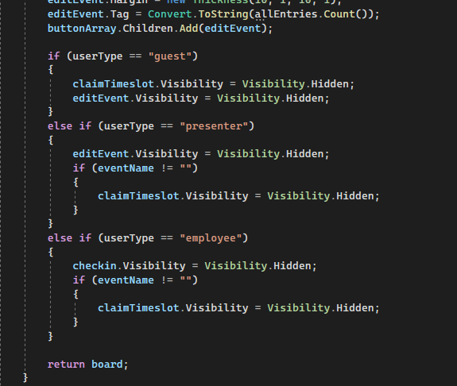
reusability
In the UI, many of the same pages were reused among the different scopes, with the pages automatically adjust what elements were visible based on what permissions the user had, reducing clutter and project size

Slide 10
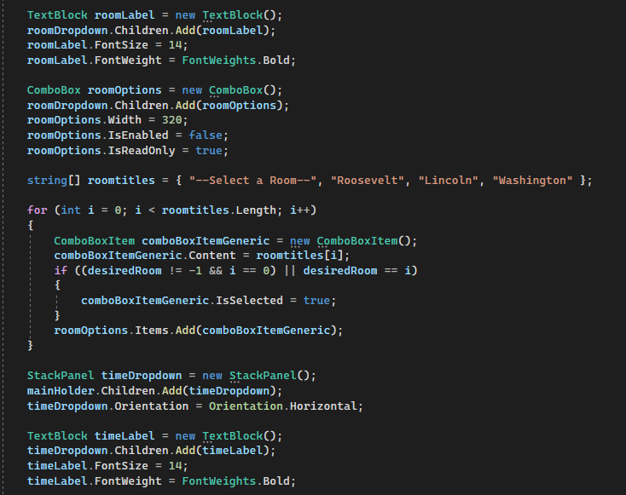
Dynamically Generated containers

Slide 11
Any Questions?

